Slide 1

UNIVERSITY INSTITUTE OF SCIENCES
Academic Unit I
Bachelor of Engineering (Computer Science & Engineering)
Biology For Engineers 23SZ148
INTRODUCTION
Measurement system
DISCOVER . LEARN . EMPOWER

Slide 2
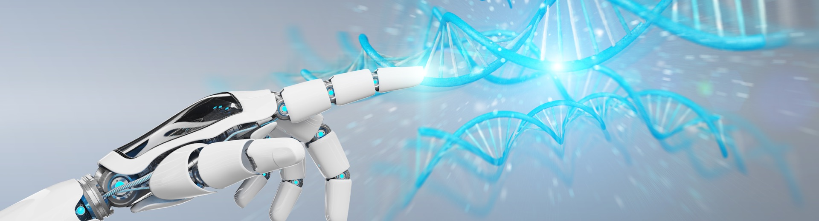
INTRODUCTION
Course Objective
This subject is designed to impart fundamental knowledge on basic of genetics and emerging fields of biology like biomedical recording system and medical instrumentation.
It is designed to impart knowledge that how to apply basics of biology in engineering.
https://www.uic.es/sites/default/files/uic-grau-bioenginyeria-hero-header_1.jpg

Slide 3

INTRODUCTION
Space for visual (size 24)
Course Outcome
CO Number | Title | Level
CO1 | Identify the biological concepts from an engineering perspective. | knowledge
CO2 | Development of artificial systems mimicking human action. | Understand
CO3 | Explain the basic of genetics that helps to identify and formulate problems | Analyze
CO4 | Apply knowledge of measurement system, biomedical recording system and biosensors to excel in areas such as entrepreneurship, medicine, government, and education. | Apply
CO5 | Integrate biological principles for developing next generation technologies, | Create
Will be covered in this lecture
https://specials-images.forbesimg.com/imageserve/1034901762/960x0.jpg?fit=scale

Slide 4
SYLLABUS
Unit-2 | Biosensors and measurement system | Contact Hours: 15
Chapter 1 Medical Instrumentation Chapter 2 Measurement System Chapter 3 Biological Sensor | Medical Instrumentation: Sources of biomedical Signals, Basic medical Instrumentation system, Performance requirements of medical Instrumentation System, Microprocessors in Medical instruments, PC base medical Instruments, General constraints in the design of medical Instrumentation system, Regulation of Medical Devices. Measurement System: Specification of instruments, Statics & Dynamic characteristics of medical instruments, Classification of errors. Statistical analysis, Reliability, Accuracy, Fidelity, Speed of responses, Linearization of technique, and Data Acquisition System. Biological sensors: Sensors/ receptors in the human body, basic organization of the nervous system- neural mechanism, Chemoreceptor: hot and cold receptors, sensors for smell, sound, vision, Ion exchange membrane electrodes, enzyme, glucose sensors, immunosensors, & biosensors & applications of biosensors.

Slide 5
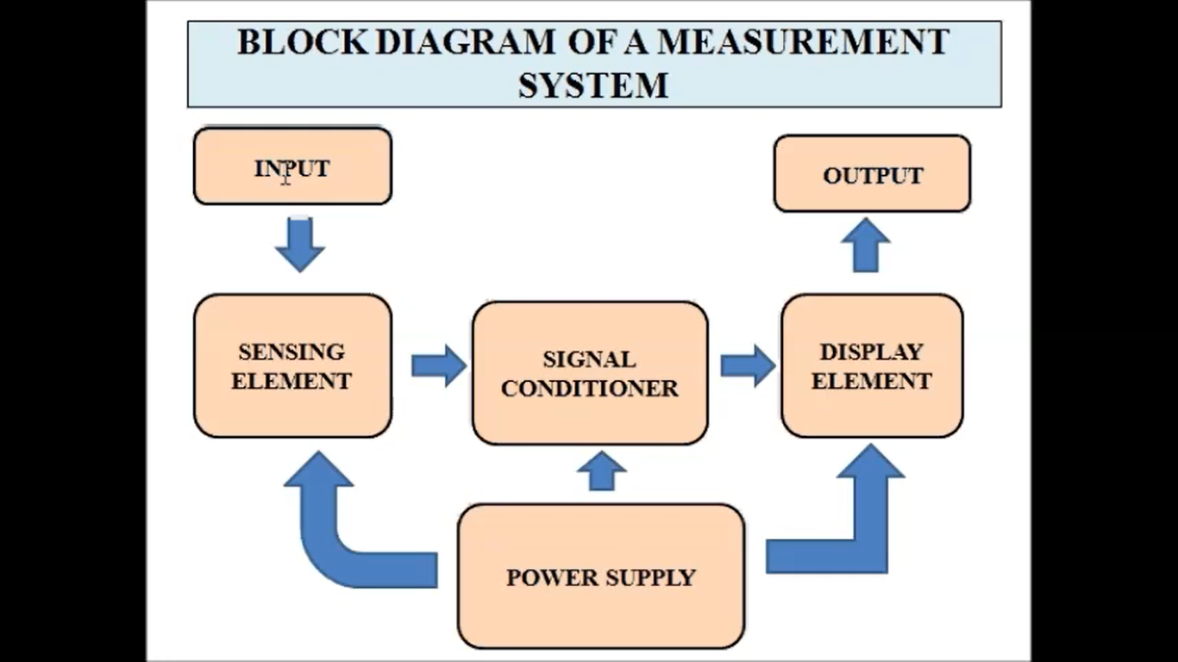
Measurement system

Slide 6
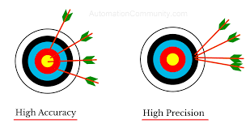
Specification of Instruments in context of medical instruments
Instrument performance is specified by range, sensitivity, resolution, accuracy, and precision.
Range is defined by the highest and lowest readings the instrument is expected to produce.
Sensitivity is the smallest change that can be sensed by a sensor.
Resolution is the smallest change that can be displayed on a readout device.
Precision is the degree to which a reading deviates from the mean of a series of readings taken under identical conditions.
Accuracy is the degree to which a reading deviates from an absolute value.

Slide 7
Different Errors in biomedical systems
Systematic errors
Random errors
Gross errors (Blunders)

Slide 8
Systematic errors
Errors caused by experiments procedure.
These are errors caused by the way in which the experiment was conducted. In other words, they are caused by the design of the system.
Poor procedure, or poor execution leads to more errors.
Systemic error can be removed by replacing the instruments and procedures.

Slide 9
Random errors
These errors are unpredictable.
Observational:
For example, errors in judgment of an observer when reading the scale of a measuring device.
Environmental:
For example, unpredictable fluctuations in line voltage, temperature, or mechanical vibrations of equipment.

Slide 10
Gross Errors (Blunders)
A final source of error, called a blunder or gross error, is an outright mistake.
These errors occur due to carelessness or lack of experience of a human
A person may record a wrong value, misread a scale, forget a digit when reading a scale or recording a measurement, or make a similar blunder.
Gross error is caused by careless handling.

Slide 11
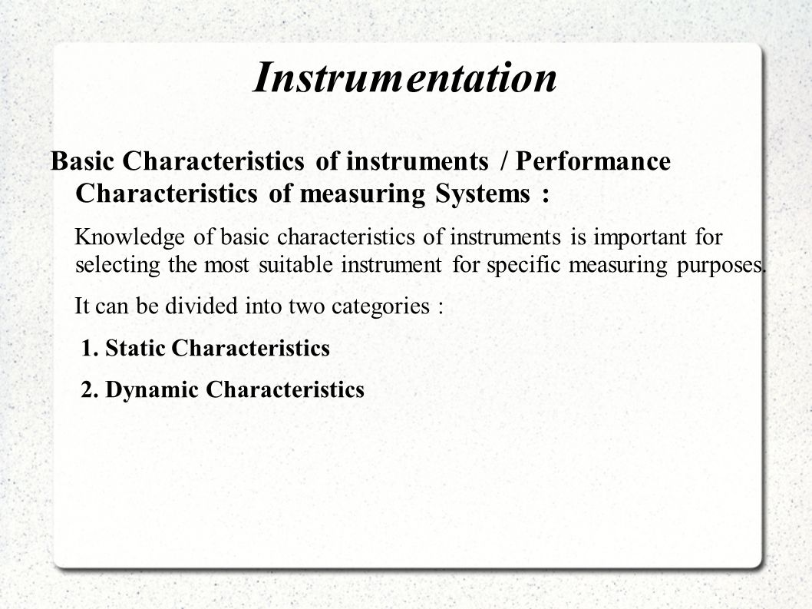
Basic Characteristics of Instruments
https://image.slidesharecdn.com/myppt2-140916110617-phpapp02/95/the-laws-of-mendel-9-638.jpg?cb=1410865730

Slide 12
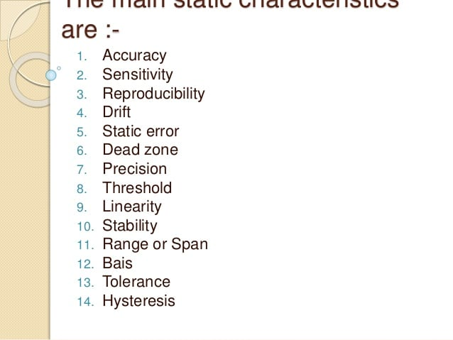
Static Characteristics
Refers to the characteristics of system when the input is either hold constant or varying very slowly with time.
12

Slide 13
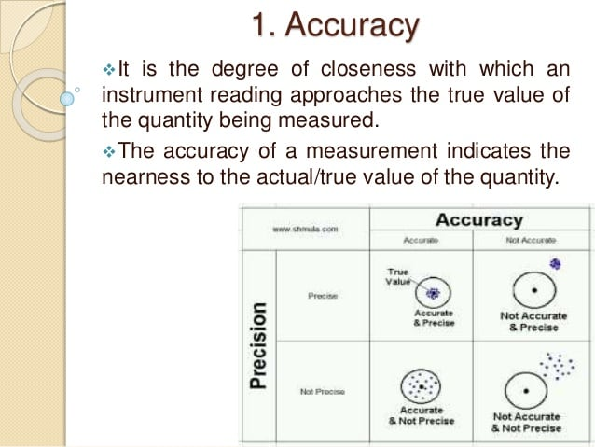

Slide 14
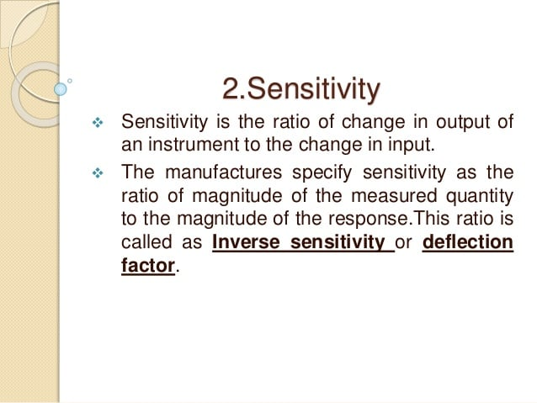
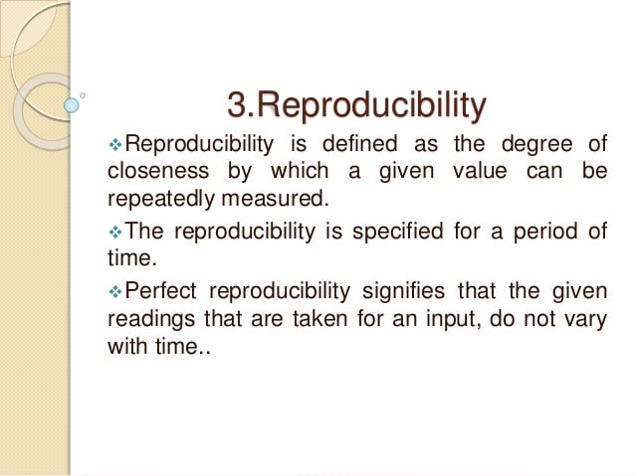
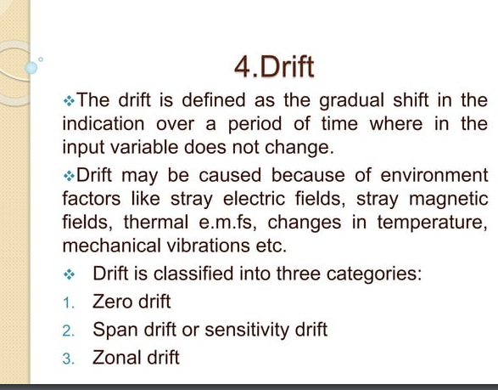

Slide 15
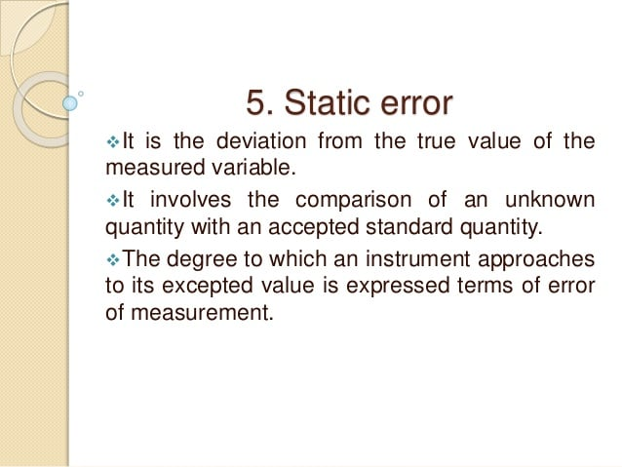
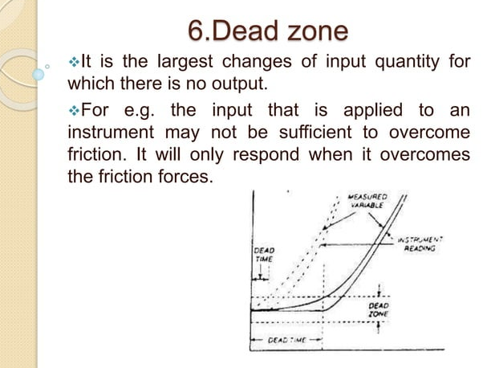

Slide 16
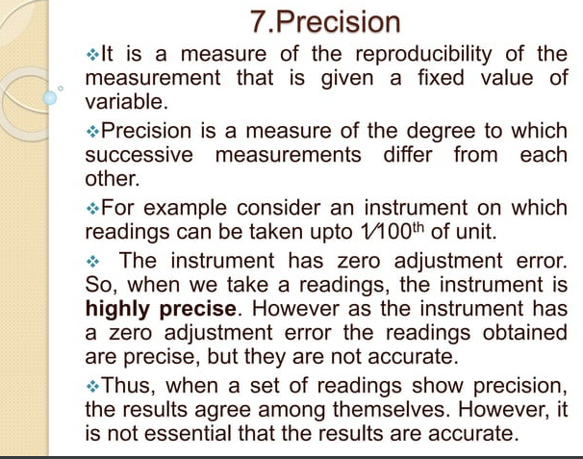
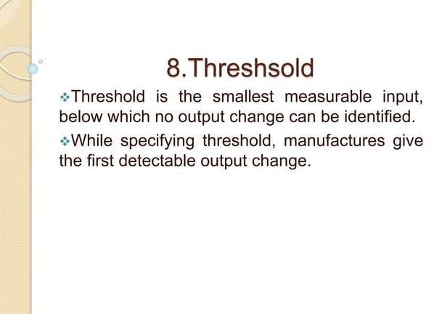
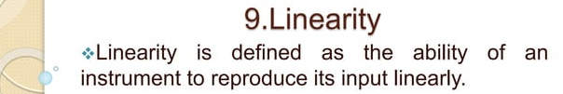

Slide 17
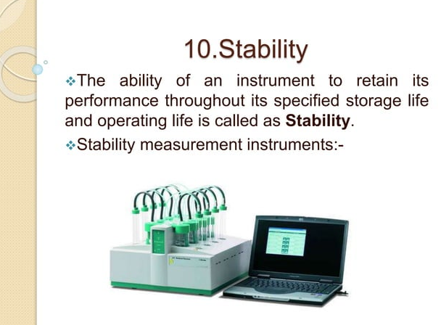
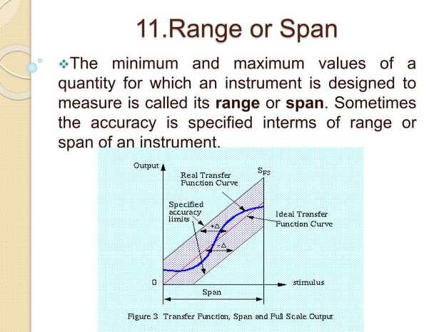

Slide 18
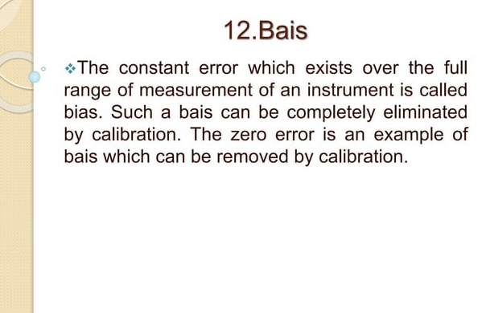
Bias

Slide 19
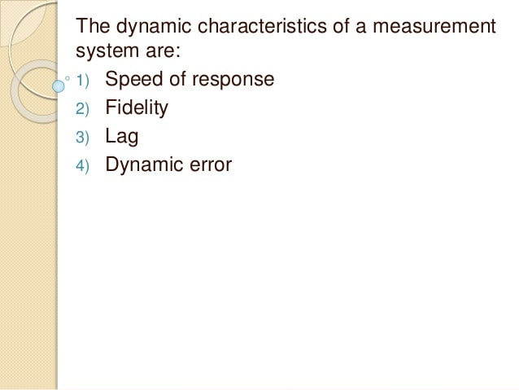
Dynamic Characteristics refers to the performance of instrument when the input variable is changing rapidly with time.
Dynamic Characteristics
Dynamic Characteristics refer to the performance of the instrument when the input variable is changing rapidly with time
time

Slide 20
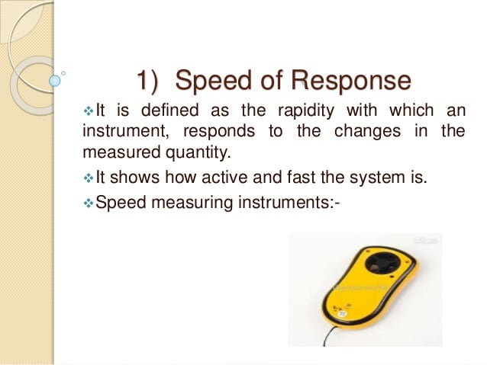
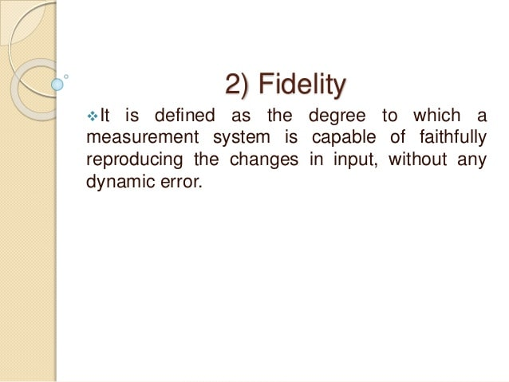

Slide 21
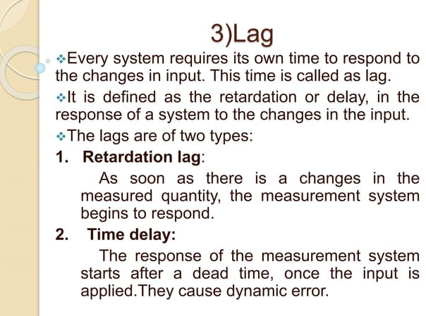
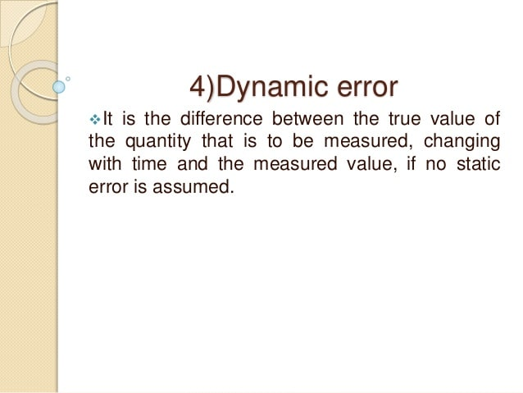

Slide 22
REFERENCES
C. R. Balamurugan and D. Periazhaagar Basics of Biomedical Instrumentation. Magnus Publications, Chennai ISBN: 978-81-939626-7-1
Gupta, P.K.. Cytology, Genetics and Molecular Biology, Rastogi Publishers, Meerut, 1993.
Roit I.M., Brostoff J. and Male D. Mosby .Immunology (6 th Edition) by, An imprint of Elsevier Sci Ltd., 2002.
G. Webster , Medical Instrumentation: Application And Design, 3rd edition ,Wiley Publishers
D Reddy, Biomedical Signal Processing, Tata Mcgraw Hill Publications.
Sergio Cerutti Advanced Methods of Biomedical Signal Processing, Oxford Publications.
B. Jacobson, J.G. Webster, Medical and Clinical Engineering, Prentice Hall, International.
Cromwell, Biomedical Instrumentation and Measurements, Prentice Hall, International.
R.S. Khandupur, Handbook of Biomedical Instrumentation, - Tata McGraw Hill
Leslie Cromwell, Fred J. Weibell, Erich A. Pfeiffer, "Biomedical Instrumentation and Measurements", Pearson Education.
https://nptel.ac.in/courses/121/106/121106008/
http://mediatoget.blogspot.in/2012/01/static-dynamic-characteristicsof.htm

Slide 23
THANK YOU

